Slide 1
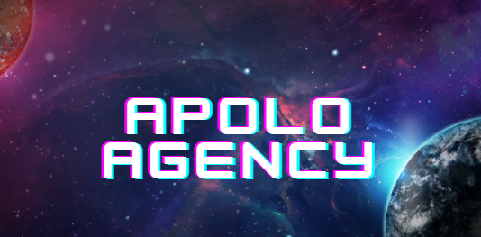

203
Basil, Koh Win, Jerryl, winston

Slide 2
ABOUT OUR GAME
01
Save a dying planet from the apocalypse in the Apocalypse Agency. An action RPG set in a constantly evolving Open-World. Fight for honor in this FPS and hunt “Uniques”.

Slide 3
Game Idea: Apolo Agency: Alliance
Target audience: Age 15-35
Target platform: Console & PC
Publishing platform: Steam, Epic, Playstation and Xbox
Genre: FPS, RPG, Action, Adventure

Slide 4
Core Mechanics
Movement: Standard fps movement mechanics
Shooting: Standard fps shooting controls
Health: Skills(Buff types), Consumables(stimpack, etc.)
Misc: Inventory, Shop, Map, Map Markers,

Slide 5
Dynamics
Movement: Sprinting, Sprint+Dodge=Slide, Direction+Dodge=Dodge Roll, Vaulting, Climbing
Attacking: Move+(Shoot,Skills,Consumables), Crouching+Aiming(increases range and accuracy), Sprint/Jump+Hip Firing, Aiming+Shoot, Use Skills
Health: Resting(slow regen), Out Of Combat+Consumable=(increased healing)
Misc: Buying/selling from store, Keep/Remove Items in Inventory, Adding Map Markers to Map

Slide 6
Aesthetics
Top 3: Challenge, Sensation, Fantasy
Hard boss fights, elements of environment
Immersive world building, visual styles and surround sounds
Live in a new world, apart from reality, in a post apocalyptic world
Extra Bits: Discovery, Self Expression, Abnegation
Explore different regions and environments
Cosmetics and Gun modding to suit your playstyle
Can farm mob zones for loot, before gearing up for boss fights

Slide 7
Visual Styles
Realism
Weather variety
Adds immersion
Adds diversity, changes gameplay
Fog of war
Muted colors
Eerie, quiet environment
Post apocalyptic effect

Slide 8

02
SIMILAR GAMES
AND HOW THEY DID

Slide 9
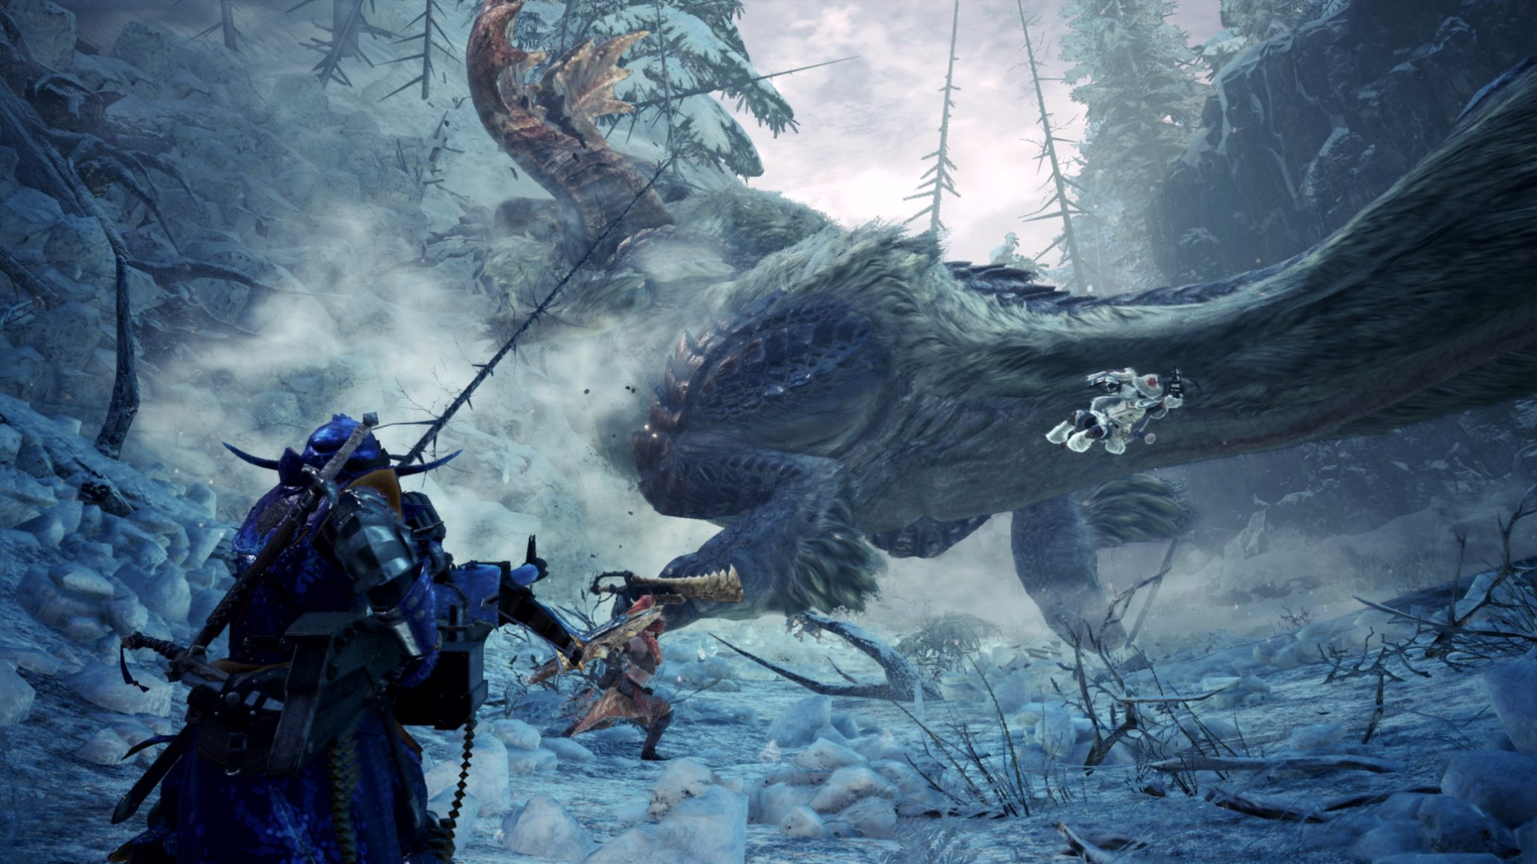
Similar Games - Monster Hunter: World
Released 26 January 2018
Regularly on the top 10 selling games on Steam
15,060 active players in Oct 2021
20 mil copies sold by Oct 2021
Main game is 41 SGD, DLC is 68 SGD
Monster Hunter: World, is CAPCOM’s largest title, amassing 105 mil in profits in 2018

Slide 10
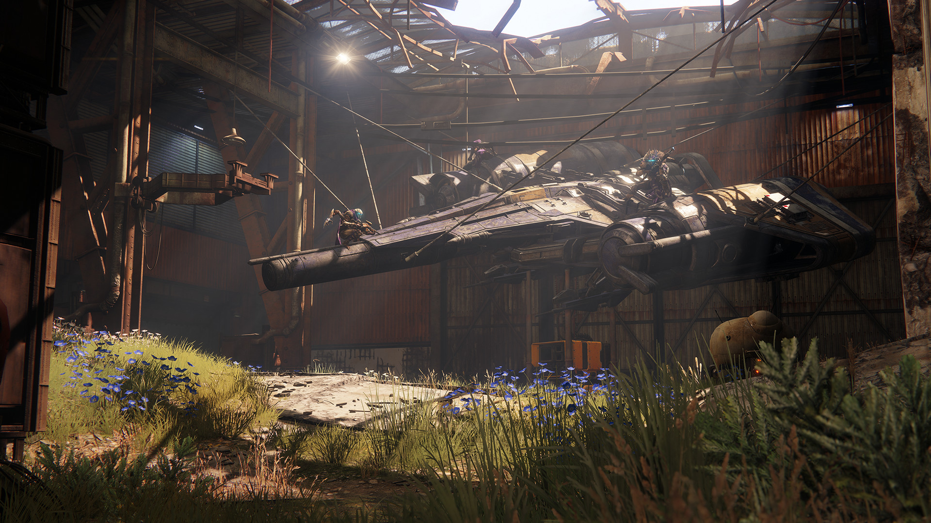
Similar Games - Destiny 2
Released 1st October 2019
Total revenue: $164 million
Total Profit: $90 million
Active players: est 70k a day
Sold 50k copies on it's first week on console
Took 1st place in sales in the UK.
Won Game critics award for best PC game for 2017
Main game: Free, DLC: $201.69 total, Legendary edition: $109.90

Slide 11
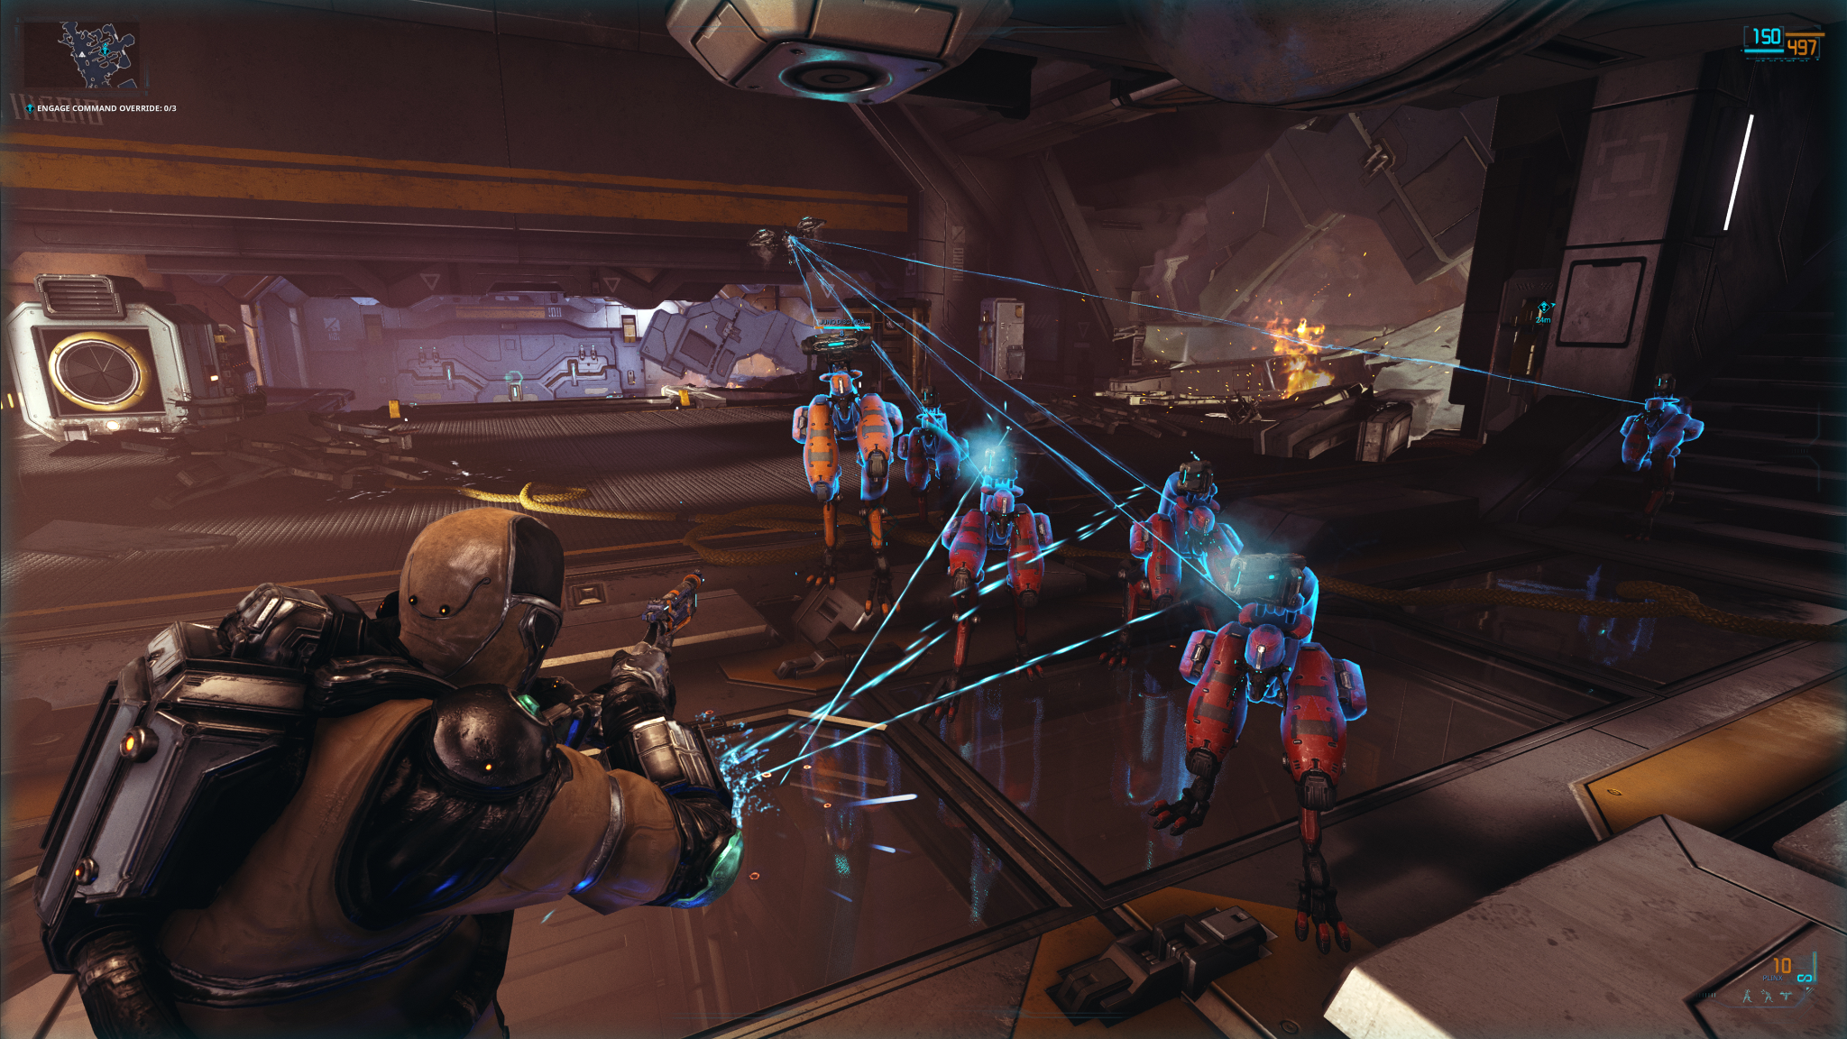
Similar Games - Warframe
Released 25 March 2013
Overall Revenue: 74.1mil USD in 2020
Active Players: 38,478.6 average players in last 30 days
Warframe is Leyou's largest title, accounting for $175 million, or 80%, of revenue generated in 2019
Game: Free
DLC: $421

Slide 12
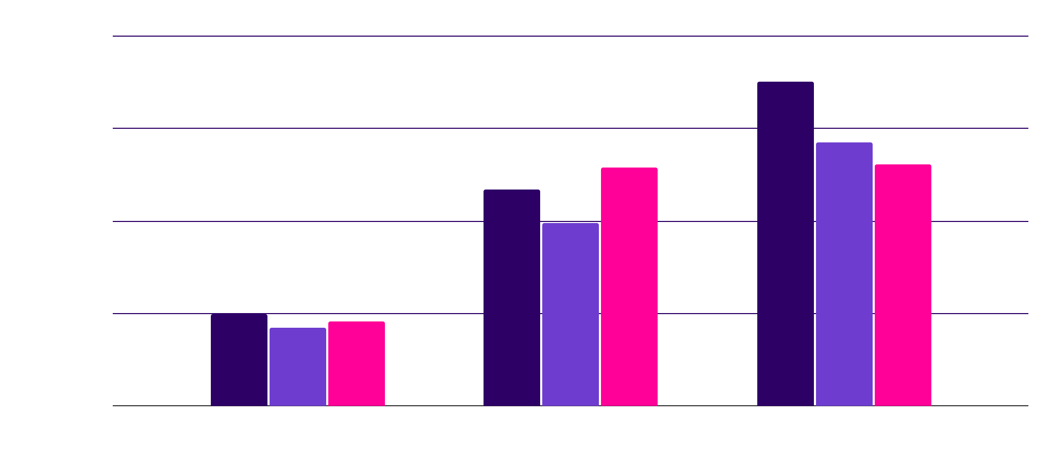
Overall analysis
Development of MH:W started about three years prior to the E3 2017 reveal, following a year of brainstorming on what the next core title in the series would be.
Warframe developers built out a playable version of the game, at the time known as Lotus in about nine months. Alongside this, the studio developed the necessary server architecture to support the game and the microtransaction system they had envisioned for it.
Destiny 1 took about 3 years to produce.
Overall: MH:World 4 (4 Years), Warframe (9 months due to time constraint), Destiny 1 (3 Years)

Slide 13
Common aspects of similar games
Common Genres:
RPG
open world
action, adventure
Common aesthetics:
Customisation
Quests / Challenges
Discovery / adventure
Common dynamics:
Boss fights
Combo movesets
Random loot drops
Scaling difficulty
Common Platforms
Steam

Slide 14

03
MARKET RESEARCH
What does data say about this?

Slide 15
BEST PLATFORM?
25% ($33.4BN)
PC GAMES
28% ($38.4BN)
CONSOLE GAMES
47% ($63.8BN)
MOBILE GAMES
Source: https://newzoo.com/insights/articles/newzoo-cuts-global-games-forecast-for-2018-to-134-9-billion/

Slide 16
MOST POPULAR GENRE?
28.2%
21.7%
13.3%
9.7%
Love Action
Love shooters
Love Sports
Love RPG’s
Source: https://www.forbes.com/sites/niallmccarthy/2015/06/26/americas-favorite-video-game-genres-infographic/?sh=738f0a705f99

Slide 17
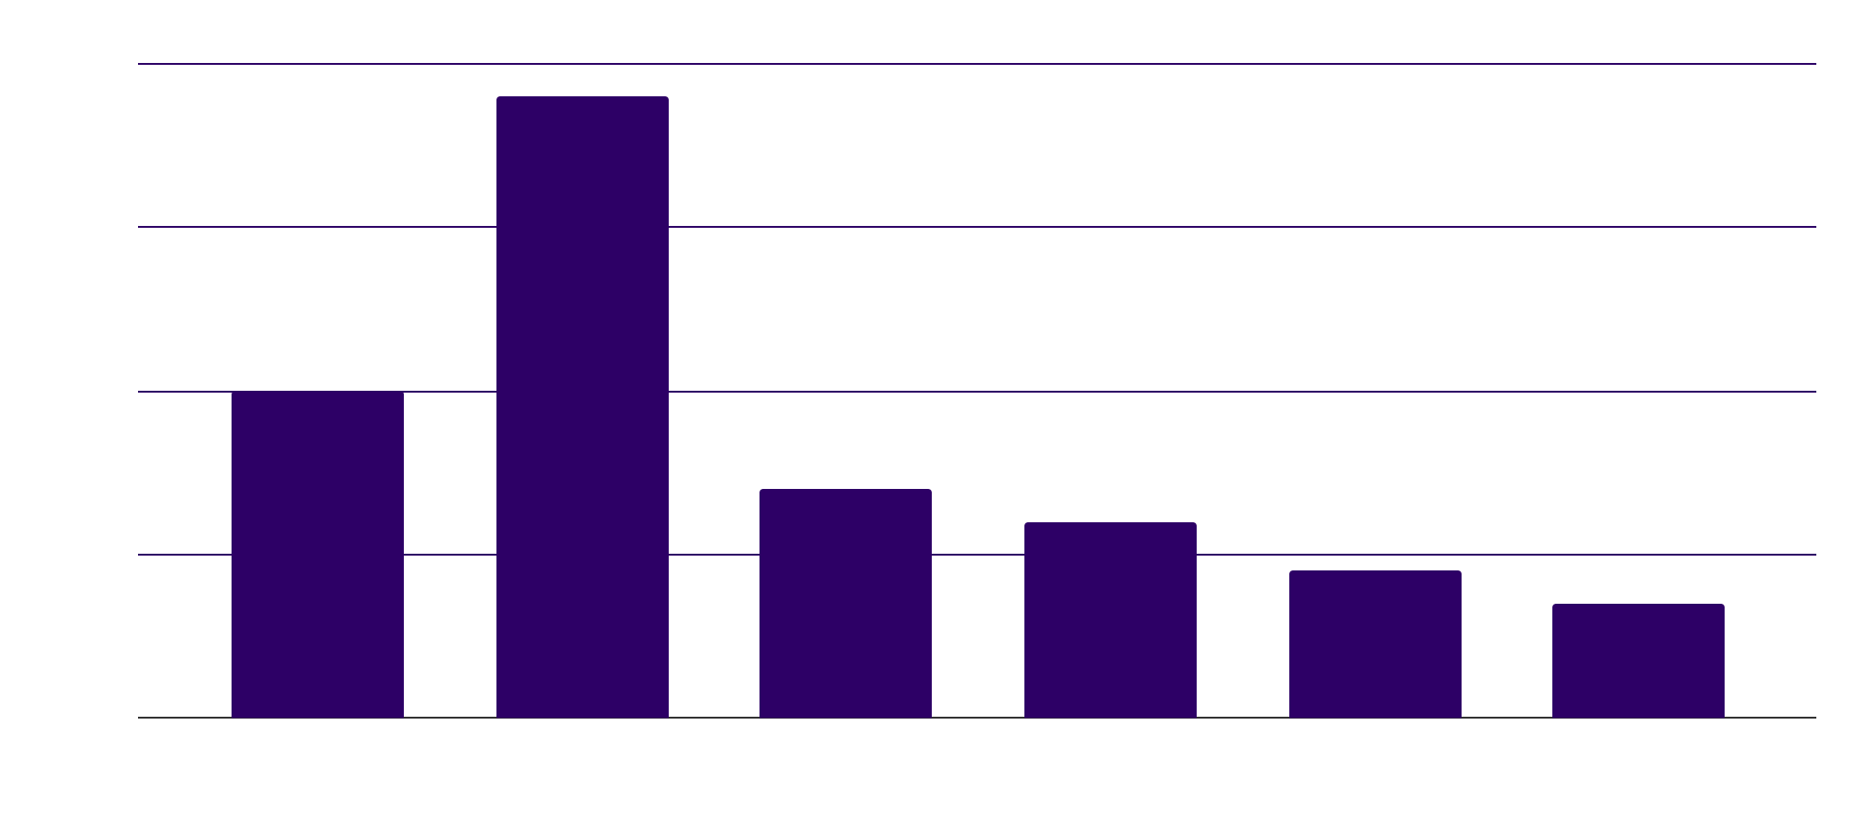
BEST TARGET AUDIENCE?
39%
https://www.statista.com/statistics/189582/age-of-us-video-game-players/

Slide 18

What does this mean for our game?
We reach a very large audience with our platform selection
Our game genre is very popular and will do well
Our target audience will make our game do better.

Slide 19
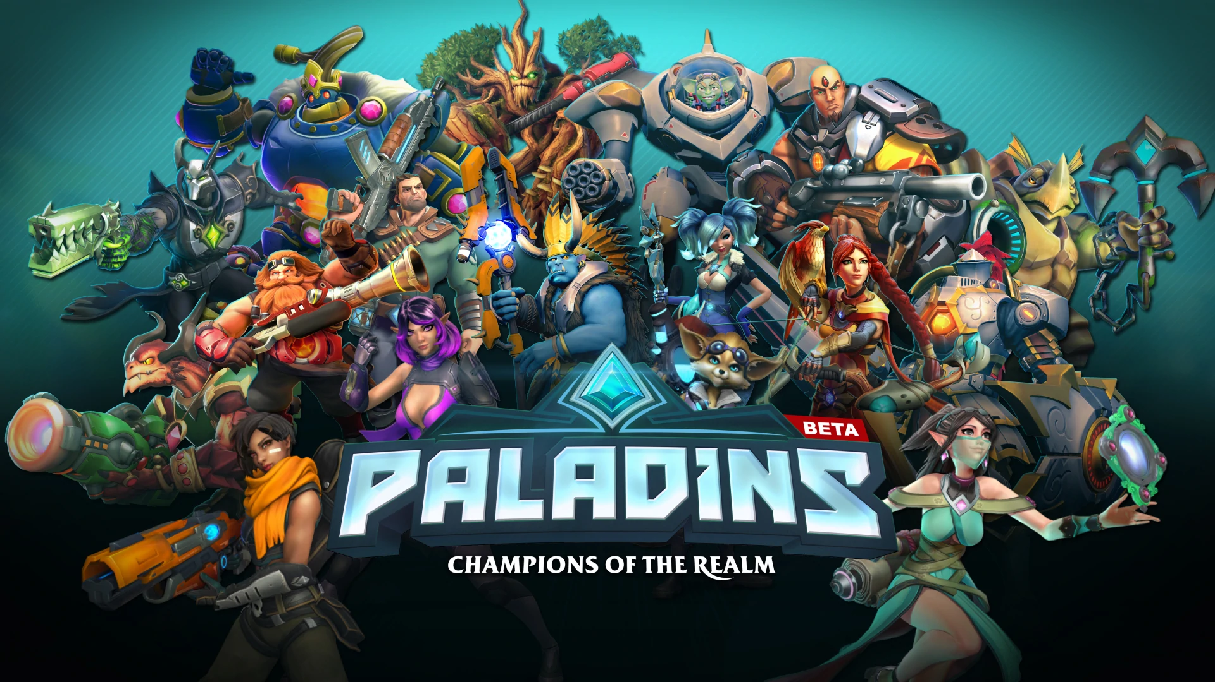
Basil’s Analysis on Paladins
Overview:A Hero Based Shooter with a MOBA Twist with different guns and abilities for every hero.
Mechanics: Shooting(AOE Damage, Hitscan, Projectile) ,Abilities(Healing, Teleporting,WallHacks)
Dynamics: Round Based Shops, Card Based Hero Building
Aesthetics: Challenge , Fellowship , expression
Rewards:more time played will give new heroes and skins to players
Risk:Need to spend time grinding for each Hero with them having different dynamics to learn.

Slide 20


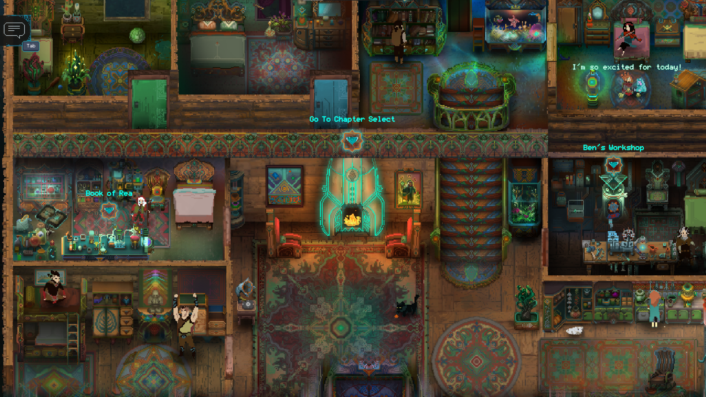
Winston’s analysis on Children of Morta
Mechanics
Aesthetics
Attack chain, skills, looting
Fantasy, Sensation, Challenge
Children of Morta is a story-driven hack & slash dungeon crawler, with action role-playing aesthetics and roguelike elements. It follows the Bergson family, custodians of Mount Morta, who must defend it from an evil called the Corruption.
Dynamics
Buying in shop, using runes, solving puzzles, upgrades(skill tree/home)

Slide 21
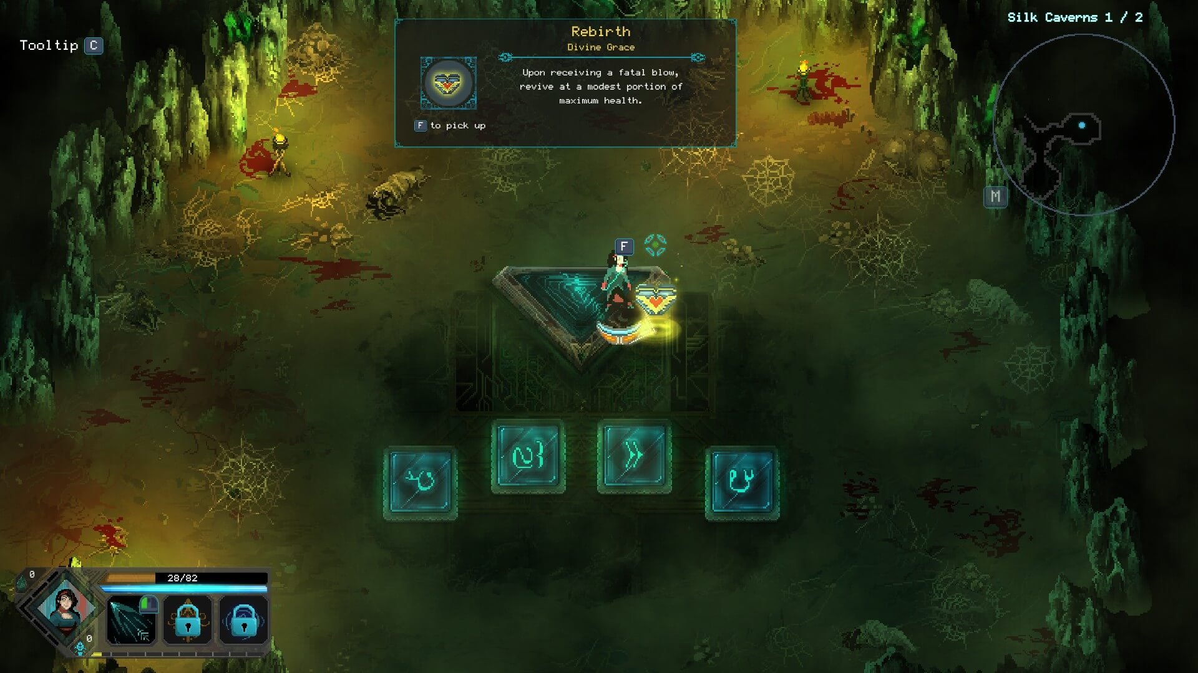
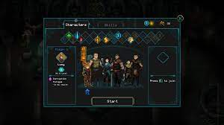
Risk/Rewards
Motivation
Pros
Cons
SOULS
Immersive storyline
Kill bosses
Unlimited replayability
Procedurally generated rooms
Balanced gameplay
Low difficulty
Too balanced gameplay
Low skill threshold

Slide 22
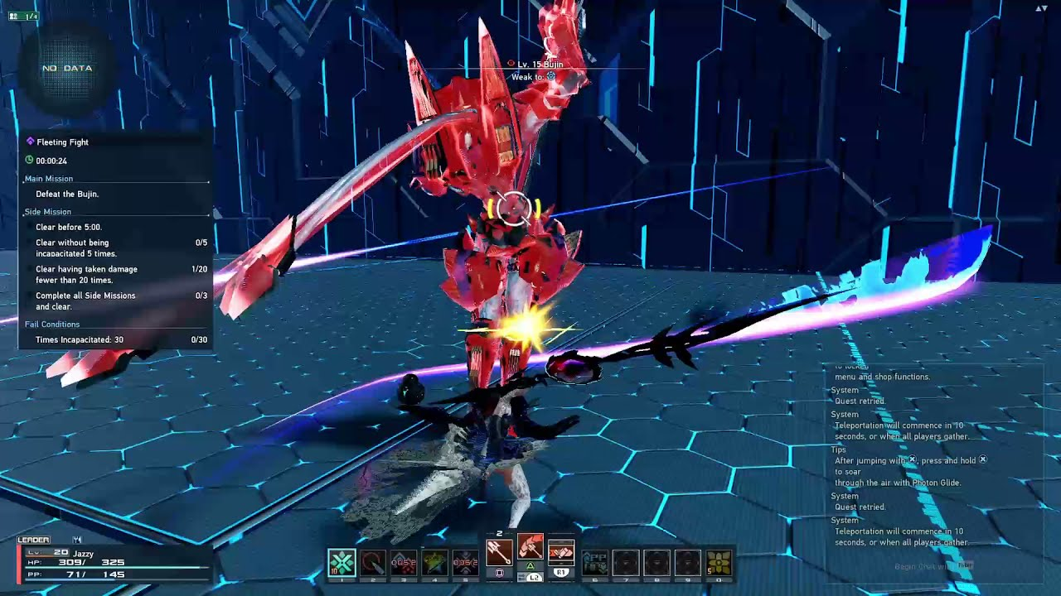
Jerryl’s Analysis on PSO2:NGS
PSO2:NGS is an MMORPG with an open world for the players to explore and grind for equipment and levels to upgrade their weapons and classes
Mechanics:
Basic/Charged Attacks, Double Jump, Glide
Dynamic:
Purchasing and selling on the community store
Risk: Dying
Rewards/Motivation:
Better Weapon/Armour Drops
Aesthetics:
Fantasy

Slide 23
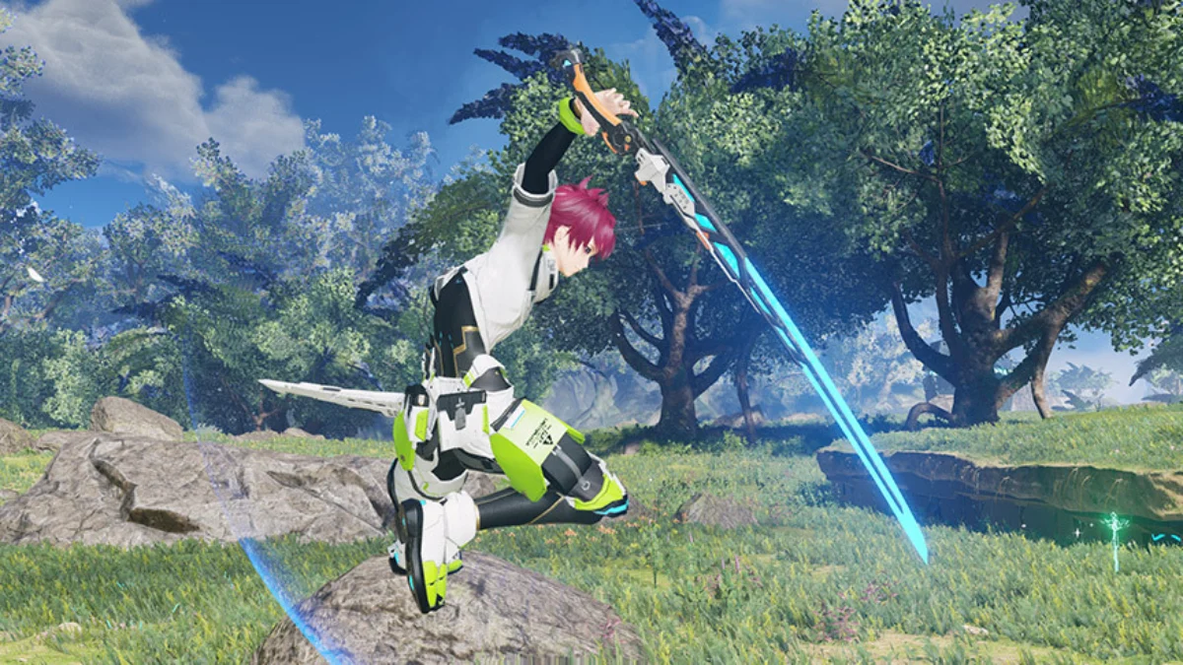
Pros and Cons
Pros:
Improved character models
Satisfying combat advancements and achievements
Fun movement mechanics
Sizable map area
Cons:
Lack of new content
Players hit the cap quickly
Deters commitment from players

Slide 24
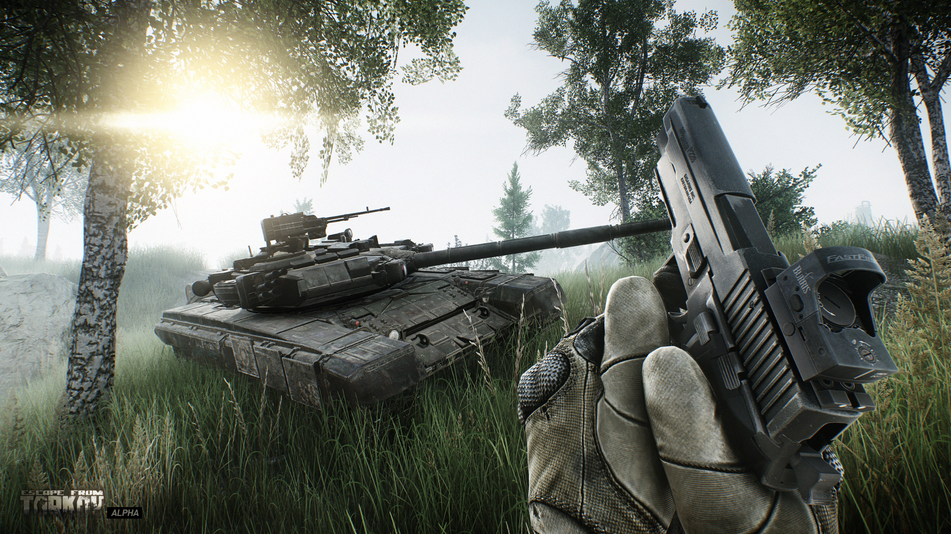
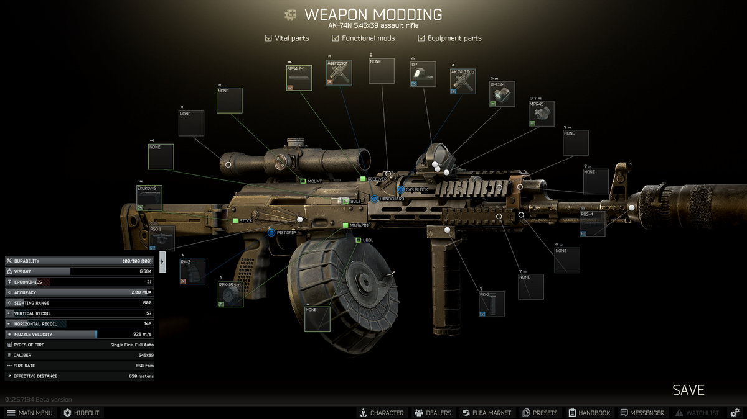
Koh Win’s analysis on ESCAPE FROM TARKOV
Overview: Escape from tarkov is a realistic hardcore online FPS/RPG with MMO elements and a story driven walkthrough.
Mechanics: Shooting, Running, looting, consumables
Dynamics: Power sliding, selling, crafting, questing, modding

Slide 25
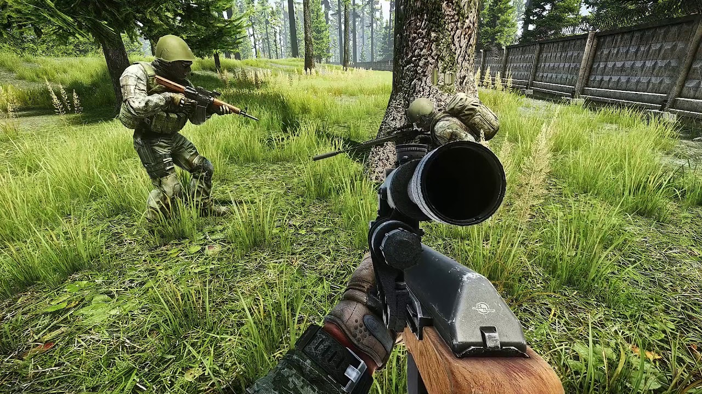
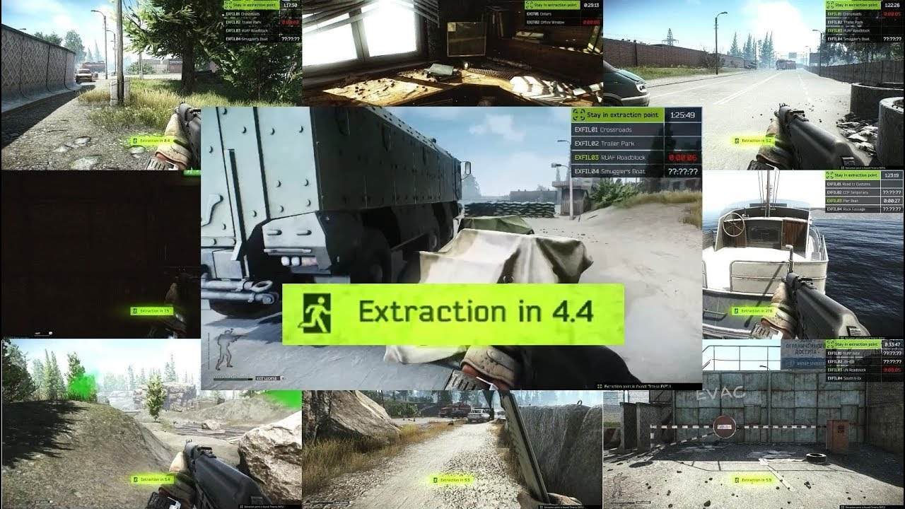
Koh Win’s analysis on ESCAPE FROM TARKOV
AESTHETICS
RISK/REWARD
PROS/CONS
Fellowship, sensation, challenge
Extract from raid or lose all gear you brought with you
Optimization and patches. One of a kind

Slide 26
References
https://www.theverge.com/2019/6/19/18682599/monster-hunter-world-iceborne-preview-kaname-fujioka-interview-e3-2019
https://samacharcentral.com/if-you-play-destiny-2-on-pc-consider-not-alt-tabbing-for-a-bit/
https://www.noobfeed.com/news/12105/warframe-the-new-war-coming-this-year-cross-play-and-mobile-release-confirmed
https://vsbattles.fandom.com/wiki/Paladins:_Champions_of_the_Realm
https://gamesgds.com/phantasy-star-online-2-how-to-take-best-screenshot-hiding-ui/

Slide 27
Task Allocation Break-down
Basil: slides, similar games, overview
Winston: slides, similar games, overview, mechanics, dynamics, aesthetics
Jerryl: slides, similar games, mechanics and dynamics
Koh Win: Slides design, market research, visual styles and aesthetics

